Slide 1
HYBRID DOCUMENT SUMMERIZATION
Submitted by,
Naveen Pandurangi(1VK15CS034)
Nikhil Chandran(1VK15CS038)
Srivatsa V Jamadagni(1VK15CS054)
Mohammed Abu Talha Ahmed(1VK15CS030)
Under The Guidance Of
Mrs. Chandramma B.E,M.Tech,Ph.D
Assoc.Professor ,Dept Of CSE,VKIT

Slide 2
HYBRID DOCUMENT SUMMERIZATION
INTRODUCTION :
Document Summarization is the technique by which the huge parts of content are retrieved.
The Document Summarization plays out the summarization task by unsupervised learning system.
The significance of a sentence in info content is assessed by the assistance of Simplified Lesk calculation.
A specific word may have distinctive significance in various setting.
To begin with, Document Summarization assesses the weights of the considerable number of sentences of a content independently utilizing the Simplified Lesk calculation and orchestrates them in diminishing request as indicated by their weights.

Slide 3
PROBLEM STATEMENT
Reading the whole document, dismembering it and isolating the critical thoughts from the crude content require some serious energy and exertion.
Existing system increase the human effort while creating a synopsis.
A few vital products compress records as well as website pages.
The persons cannot quickly determine which points are imported for reading.

Slide 4
PROPOSED SYSTEM
In the Hybrid Document Summarization, we are using a solitary or single input content is going to outlined by the given rate of summarization utilizing unsupervised learning.
In any case, the streamlined lesk’s computation is associated with each of the sentences to find the guarantees of each sentence.
After that, sentences with induced weights are composed in sliding solicitation concerning their weights.
Presently as per a particular rate of summarization at a specific occurrence, certain quantities of sentences are chosen as an outline.
The proposed computations, abridges solitary or single report content utilizing unsupervised learning approach.
Here, the heaviness of every sentence in a substance is resolved using streamlined Lesk’s computation and wordnet.
After that, summarization procedure is performed as indicated by the given rate of synopsis.

Slide 5
Litearture SURVEY
Document Summarization is the technique by which the huge parts of content are retrieved.
The Document Summarization plays out the summarization task by unsupervised learning system.
The significance of a sentence in info content is assessed by the assistance of Simplified Lesk calculation.
A specific word may have distinctive significance in various setting. So, the principle task of word sense disambiguation is to decide.

Slide 6
SL No | Title | Methodology | Algorithm | Accuracy
01 | A Neural Attention Model for Abstractive Sentence Summarization | local attention-based model | Beam Search
02 | Abstractive Text Summarization using Sequence-to-sequence RNN and Beyond | RNN | -
03 | Automatic Keyword Extraction for Text Summarization : survey | - | -
04 | Summarization with Pointer-Generator Networks | Pointer generator network and CNN | -
05 | Text Summarization Techniques: A Brief Survey | Frequency Driven Approaches | -
06 | Ranking Sentences for Extractive Summarization with Reinforcement Learning | CNN/RNN | REINFORCE algorithm

Slide 7
07 | Neural Document Summarization by Jointly Learning to Score and Select Sentences | RNN | -
08 | Machine Learning Techniques for Document Summarization: A Survey | Talks about all the methods | -
09 | Ranking with Recursive Neural Networks and Its Application to Multi-Document Summarization | R2N2/RNN | -
10 | A Neural Attention Model for Sentence Summarization | local attention-based model | Beam Search
11 | A Review Paper on Text Summarization | Natural Language Processing | -
12 | Automatic Text Summarization Using Natural Language Processing | Natural Language Processing | LESK Algorithm
13 | A Novel Technique for Efficient Text Document Summarization as a Service | Natural Language Processing | LESK Algorithm

Slide 8
14 | Automatic Text Summarization and its methods : A Review | Term frequency based method/ Graph based method/ Time based method/Clustering based method | -
15 | A Review on Automatic Text Summarization Approaches | Frequency Based Approach/Term Frequency–Inverse Document Frequency/Machine Learning Approach/Discourse Based Method | -

Slide 9
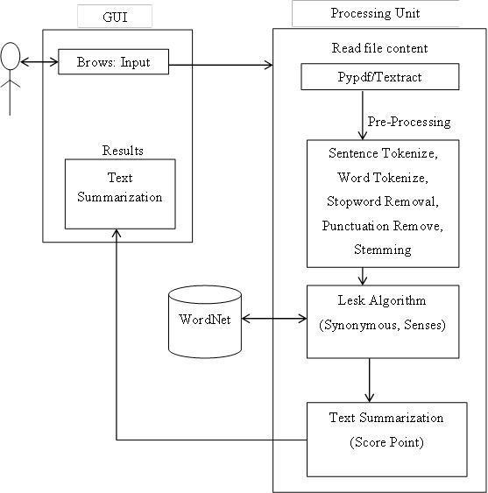
DATA FLOW MODEL

Slide 10
NLTK Tool Kit
The Natural Language Toolkit, or more commonly NLTK, is a suite of libraries and programs for symbolic and statistical natural language processing (NLP) for English written in the Python programming language.
It was developed by Steven Bird and Edward Loper in the Department of Computer and Information Science at the University of Pennsylvania.
NLTK includes graphical demonstrations and sample data.
It is accompanied by a book that explains the underlying concepts behind the language processing tasks supported by the toolkit, plus a cookbook.

Slide 11
WORDNET
WordNet is a lexical database for the English language.
It groups English words into sets of synonyms called synsets, provides short definitions and usage examples, and records a number of relations among these synonym sets or their members.
WordNet can thus be seen as a combination of dictionary, and thesaurus.
While it is accessible to human users via a web browser, its primary use is in automatic text analysis and artificial intelligence applications.
The database and software tools have been released under a BSD style license and are freely available for download from the WordNet website.
Both the lexicographic data (lexicographer files) and the compiler (called grind) for producing the distributed database are available.

Slide 12
LESK ALGORITHM
The Lesk algorithm is a classical algorithm for word sense disembogues introduced by Michael. E.Lesk in 1986.
The Lesk algorithm is based on the assumption that words in a given "neighbourhood" (section of text) will tend to share a common topic.
A simplified version of the Lesk algorithm is to compare the dictionary definition of an ambiguous word with the terms contained in its neighbourhood.
Versions have been adapted to use wordnet An implementation might look like this:
Calculation 1: This calculation compresses a single report content utilizing unsupervised learning approach. In This approach , the heaviness of each sentence in a content is determined utilizing Improved Lesk calculation and WordNet

Slide 13
THE ALGORITHM IS GIVEN BELOW
Step 1: The list of distinct sentences of the content is prepared.
Step 2: Repeat steps 3 to 7 for each of the sentences.
Step 3: A sentence is gotten from the list.
Step 4: Stop words are expelled from the sentence as they don't take an interest straightforwardly in sense assessment system.
Step 5: Glosses(dictionary definitions) of all the important words are extricated utilizing the WordNet.
Step 6: Intersection is performed between the sparkles and the information content itself.
Step 7: Summation of all the crossing point comes about speaks to the heaviness of the sentence.
Step 8: Weight appointed sentences are arranged in descending request concerning their weights.
Step 9: Desired number of sentences are chosen by the level of summarization.
Step 10: Selected sentences are re-orchestrated by their real sequence in the info content.
Step 11: Stop.

Slide 14
ADVANTAGES
Reading the whole document, dismembering it and isolating the critical thoughts from the crude content require some serious energy and exertion.
Perusing a document of 600 words can take no less than 10 minutes.
Programmed outline programming condense writings of 500-5000 words in a brief instant.
This enables the client to peruse less information yet get the most essential data and make strong conclusion.
It reduces the human effort while creating a synopsis.
A few vital products compress records as well as website pages. The persons quickly determine which points are imported for reading.

Slide 15
CONCLUSION
Automatic Text Summarization approach depends on upon the semantic data of the concentration in a substance.
So this way, gathered parameters like approaches, spots of different substances are not considered.
In this recommendation, Lesk mean for word sense disambiguation by utilizing the vocabulary definitions to the electronic dictionary information base on utilizing wordnet.
This goal is clear from covering sentence, couple of fusing words that give the setting of the word, in this not utilizing the late using the definitional shines of those words, other than those of words related to them through with the unmistakable relations portrayed in wordnet.

Slide 16
THANK YOU

